Slide 1


WEB APLICATIONS PROGRAMMING-1
Group: 603CSE
Team Members:
-Burkay ALGUL
-Tolgahan YAPICI

Slide 2
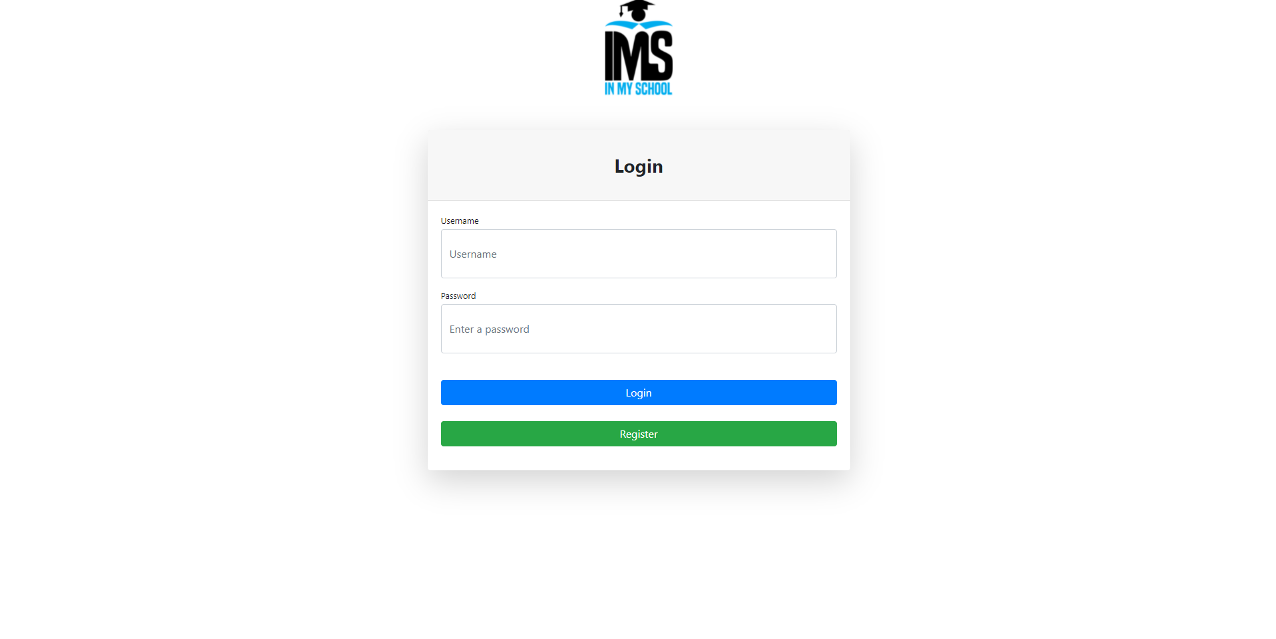
LOGIN PAGE
In our site the first page users get to see is the login page.
Here we have the username and password which are necessary to get to the main page.
The username and the password is being checked from the database and that’s why it should be the same as the one registered otherwise it will give a warning that one of them is wrong.
Also, there is the register button which is for the persons who don’t have any account yet.

Slide 3
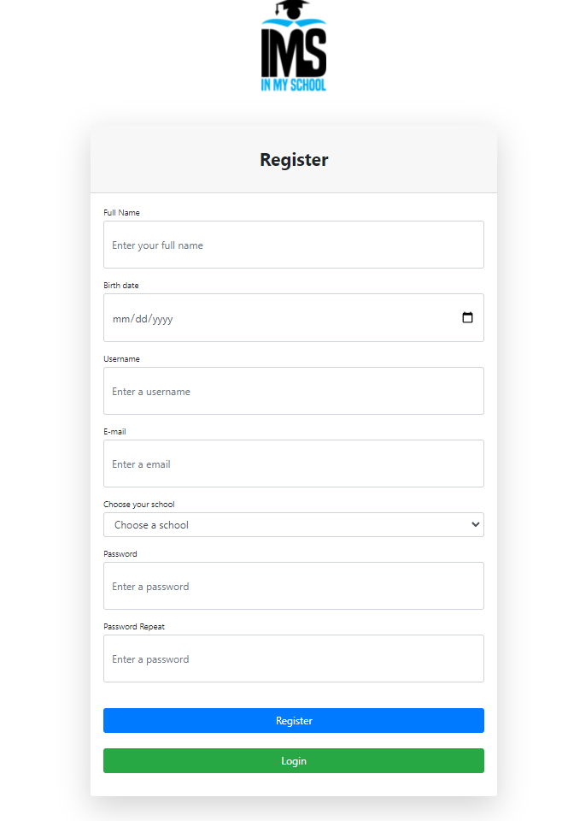
REGISTRATION PAGE
In registration page we require some information from the users like :
Full name
Birth date
A username
E-mail
To choose their school
Password
And of course, to re-enter the password
Here in birthdate, it is required to be 18 or above to register.
And we verify if the entered password is the same as the one re-entered.

Slide 4
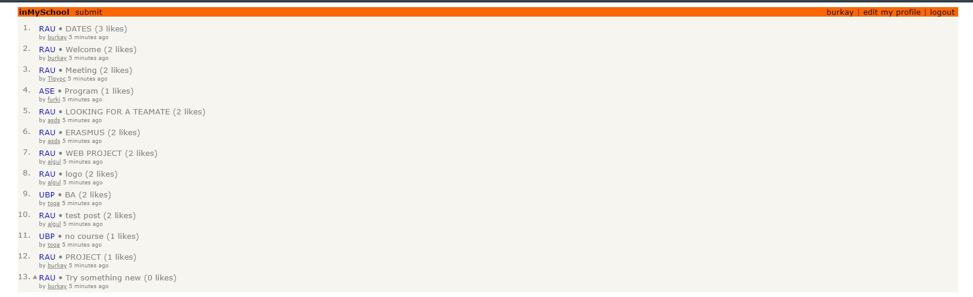
MAIN PAGE
In main page first thing users can notice is the posts that other users shared.
To the left of the posts there is located the annotations for the university of the person who shared.
We also have the like button and at the right side of the post we located the number of likes totally.
In between of them we have the topic of the subject inside the post.
And also, the share button where users can share our website for other people
In main page we welcome the students with options such as:
Submit page
Personal profile (where the username is located)
Edit my profile/settings
logout

Slide 5
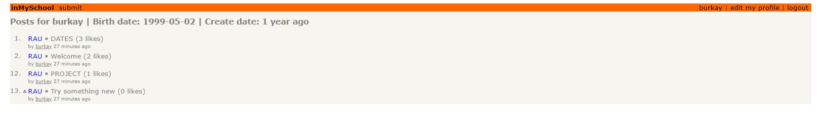
PERSONAL PROFILE
In personal profiles we located the personal information of the student such as birthdate and when was the profile created.
Under profile we also show the contents/posts which this user shared in our website.

Slide 6
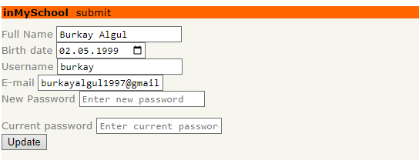
SETTINGS
Edit my profile page is simple to use
Here users can edit their full name , birthdates
They can change their usernames ,e-mails and passwords

Slide 7
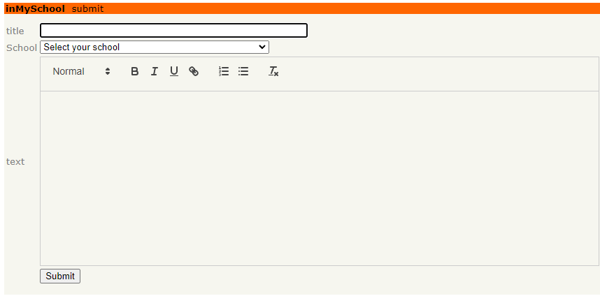
POST SUBMIT PAGE
Here in submit page we located:
Title
School/university select
Text section
Submit button
in school section users choose in which university group they would like to make the share.
In text section we developed a rich html editor so that the user can edit their posts how ever they want

Slide 8
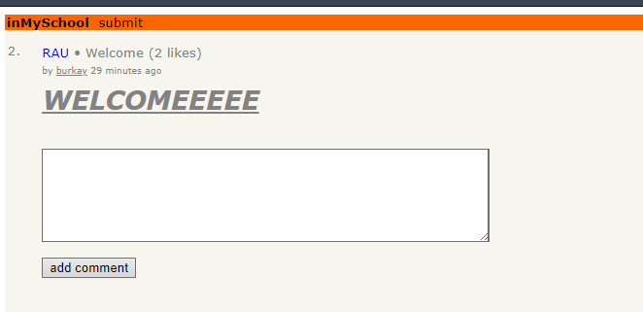
POST LIKE/COMMENT PAGE
From main page when users select a specific post they get into the page where they can read the subject underneath the title, they can like the post and they can enter a comment for the post.

Slide 9
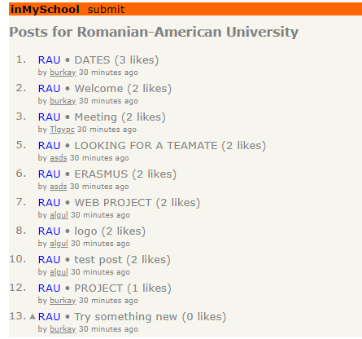
GROUPED POSTS
We also created a page where users select a specific annotation and get to the grouped section. Where the posts are filtered by the university.
Users can see who and when the content has been shared

